Slide 1



AI Master Class series – Day 7
Face recognition using Computer Vision

Slide 2
Day-6 Agenda.
01.
02.
03.
Face recognition
Overview on Recognizers
Face recognition
Face recognition & its application
LBPHFaceRecognizer & FisherFaceRecognizer
Creating dataset & Face recognition

Slide 3
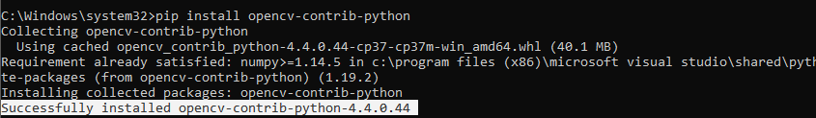
Installing Libraries
OpenCV-Contrib: pip install opencv-contrib-python

Slide 4
Face recognition.
Face recognition is a method of identifying or verifying the identity of an individual using their face. Face recognition systems can be used to identify people in photos, video, or in real-time.
Preventing crime
Unlock device
Blind assistance
Attendance system
Payments

Slide 5
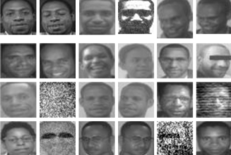
Fisherface Recognizer.
Fisherfaces algorithm extracts principle components that separates one individual from another. So , now an individual's features can't dominate another person's features.
Fisherface method will be applied to generate feature vector of facial image data used by system and then to match vector of traits of training image with vector characteristic of test image using euclidean distance formula

Slide 6
LBPHFaceRecognizer.
Local Binary Pattern (LBP) is a simple yet very efficient texture operator which labels the pixels of an image by thresholding the neighborhood of each pixel and considers the result as a binary number.
It doesn't look at image as a whole, but instead tries to find its local structure by comparing each pixel to its neighboring pixels.
LBPH uses 4 parameters
Radius - to build the circular local binary pattern and represents the radius around the central pixel. It is usually set to 1.
Neighbors - : The more sample points you include, the higher the computational cost. It is usually set to 8
X Grid - the number of cells in the horizontal direction.
Y Grid - the number of cells in the vertical direction.

Slide 7
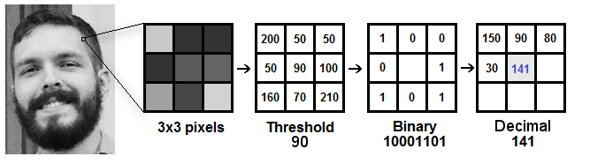
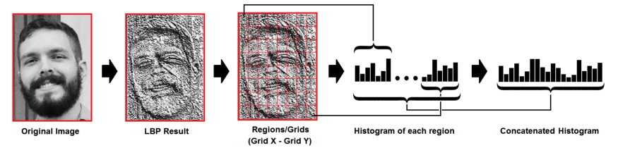
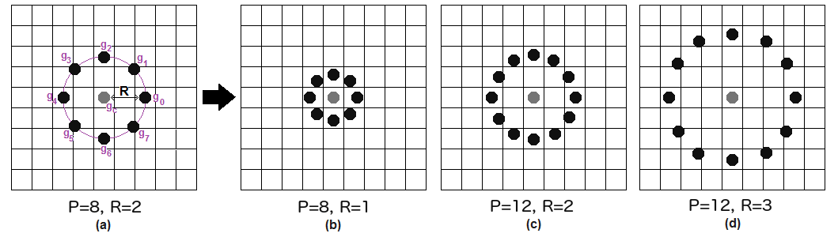
Circular LBP

Slide 8
Block Diagram – Workflow of Face recognition.
Loading face detection algorithm
Loading Classifier for face recognition
Training classifier for our dataset
Reading frame from camera & pre-processing
Face detection by its algorithm
Predicting face by loading frame into model
Displays recognized class with its accuracy

Slide 9

Practical session

Slide 10
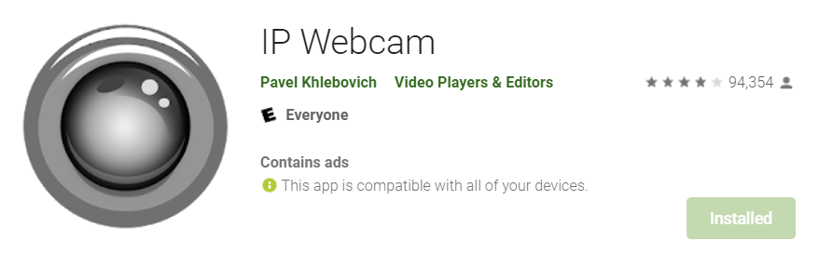
Using Android Mobile Camera for your application IP WEBCAM

Slide 11
import urllib.request
import cv2
import numpy as np
import imutils
url='http://192.168.1.9:8888/shot.jpg'
while True:
imgPath = urllib.request.urlopen(url)
imgNp = np.array(bytearray(imgPath.read()), dtype=np.uint8)
img = cv2.imdecode(imgNp, -1)
img = imutils.resize(img, width=450)
cv2.imshow("CameraFeed",img)
if ord('q') == cv2.waitKey(1):
exit(0)

Slide 12
Creating Dataset

Slide 13
Face Recognition

Slide 14
import cv2, numpy, os
size = 4
haar_file = 'haarcascade_frontalface_default.xml'
datasets = 'datasets'
print('Training...')
(images, labels, names, id) = ([], [], {}, 0)
for (subdirs, dirs, files) in os.walk(datasets):
for subdir in dirs:
names[id] = subdir
subjectpath = os.path.join(datasets, subdir)
for filename in os.listdir(subjectpath):
path = subjectpath + '/' + filename
label = id
images.append(cv2.imread(path, 0))
labels.append(int(label))
id += 1
(width, height) = (130, 100)
(images, labels) = [numpy.array(lis) for lis in [images, labels]]
model = cv2.face.LBPHFaceRecognizer_create()
#model = cv2.face.FisherFaceRecognizer_create()
model.train(images, labels)
# Part 2: Use fisherRecognizer on camera stream
face_cascade = cv2.CascadeClassifier(haar_file)
webcam = cv2.VideoCapture(0)
cnt=0

Slide 15
while True:
(_, im) = webcam.read()
#im = imutils.resize(im, width=200)
gray = cv2.cvtColor(im, cv2.COLOR_BGR2GRAY)
faces = face_cascade.detectMultiScale(gray, 1.3, 5)
for (x,y,w,h) in faces:
cv2.rectangle(im,(x,y),(x+w,y+h),(255,255,0),2)
face = gray[y:y + h, x:x + w]
face_resize = cv2.resize(face, (width, height))
#Try to recognize the face
prediction = model.predict(face_resize)
cv2.rectangle(im, (x, y), (x + w, y + h), (0, 255, 0), 3)
if prediction[1]<800:
cv2.putText(im,'%s - %.0f' % (names[prediction[0]],prediction[1]),(x-10, y-10), cv2.FONT_HERSHEY_PLAIN,1,(255, 0, 0))
print (names[prediction[0]])
cnt=0
else:
cnt+=1
cv2.putText(im,'Unknown',(x-10, y-10), cv2.FONT_HERSHEY_PLAIN,1,(0, 255, 0))
if(cnt>100):
print("Unknown Person")
cv2.imwrite("input.jpg",im)
cnt=0
cv2.imshow('OpenCV', im)
key = cv2.waitKey(10)
if key == 27:
break
webcam.release()
cv2.destroyAllWindows()

Slide 16
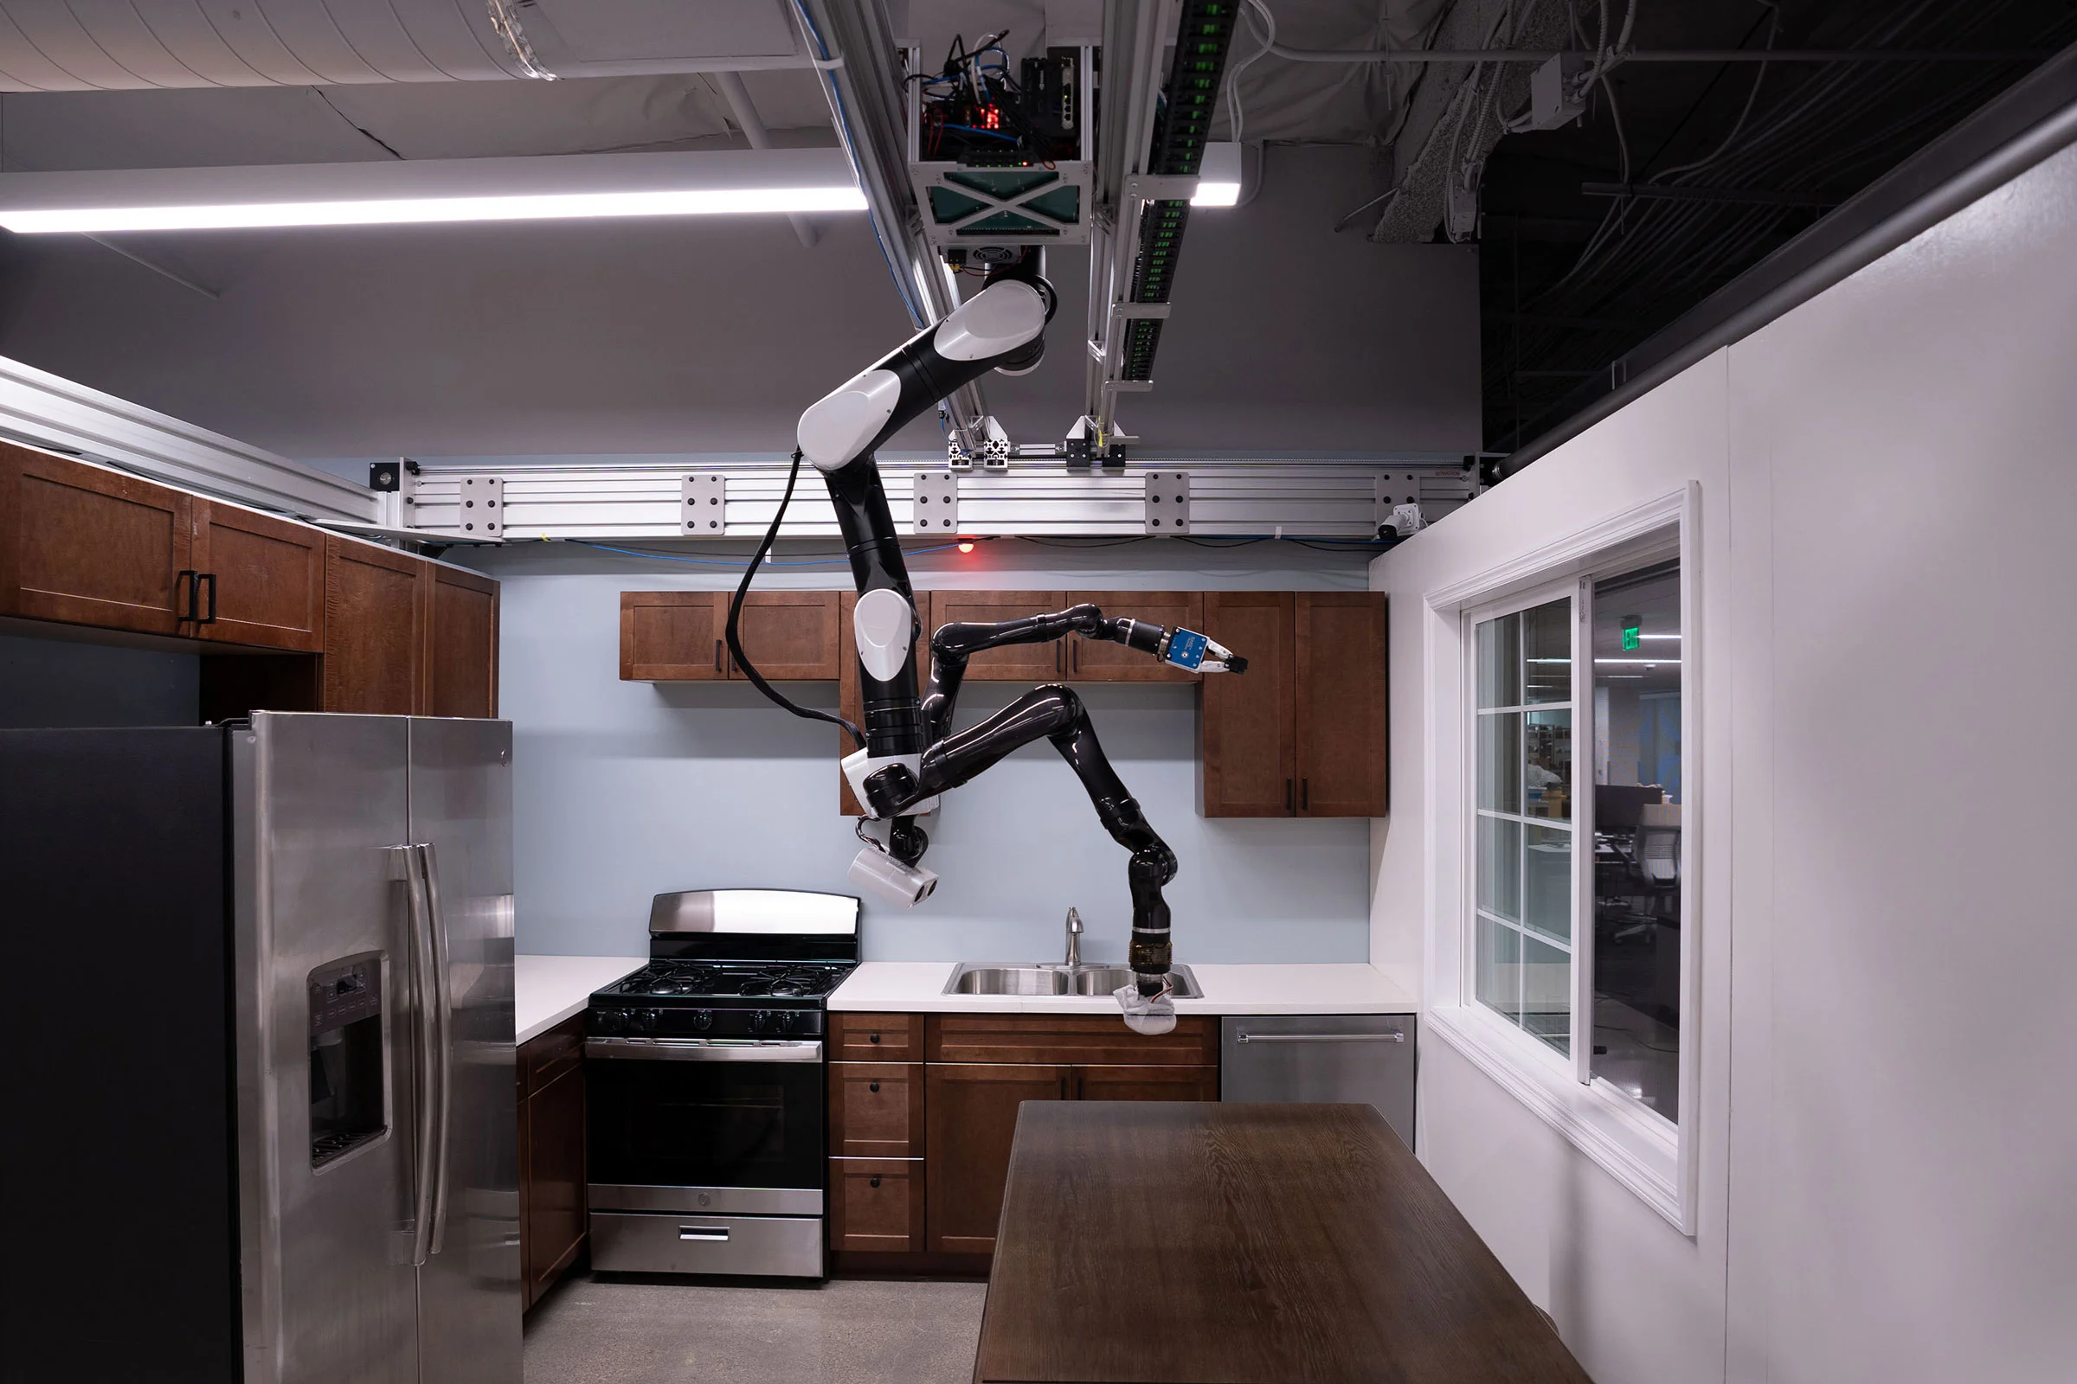
AI News – Day 7. Sept - 2020
The cleaning robots live inside a mock home located at the Toyota Research Institute in Los Altos, California. The institute’s researchers are testing a range of robot technologies designed to help finally realize the dream of a home robot.
Home, a robot suspended from the ceiling slowly expands arms holding a sponge, before carefully wiping a kitchen surface clean. Nearby, another robot gently cleans a flat-screen television, causing it to wobble slightly.

Slide 17

Thanks!
Tomorrow session
Do you have any questions?
sanjay@pantechmail.com
www.pantechsolutions.net
Face Emotion using OpenCV

